Slide 1
2D Platformer
Precision and the importance of Point-Of-View
VCE VET IDMT

Slide 2
Contents
Recap on platforming
What makes 2D platforming different?
2D Character Control
2D Perspective
2D Level Design

Slide 3
Recap on platforming
All of the rules that apply to 3D platformers also apply to 2D platformers.
No leaps of faith
Precise collisions with platforms
Precise control of movement

Slide 4
What makes 2D platforming different?
Control
Perspective
1 less dimension

Slide 5
2D Character Control
Most 2D platformers will only have 4 directions of movement.
Up
Down
Left
Right

Slide 6
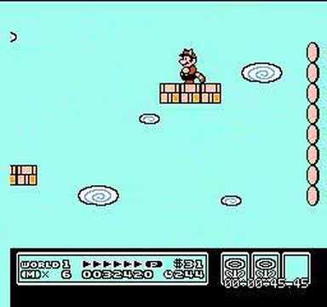
2D Character Control
This is simpler than it is in 3D, which means other aspects of 2D platformers can be more complicated.
Level design especially.

Slide 7
2D Character Control
True-to-life physics is rarely used in 2D Platformers.
Makes accurate platforming very difficult
Makes precise control of your character almost impossible
Don’t rely on a physics engine to move your character.

Slide 8
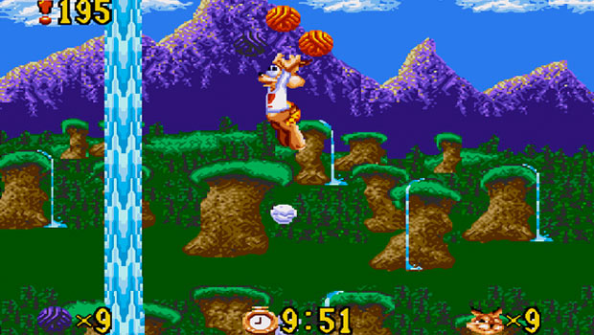
2D Perspective
2D platformers are typically played from a side-on perspective. This gives you the clearest view of what’s ahead.
As long as you can see far enough ahead

Slide 9
2D Perspective
The camera should keep your character in view at all times, whilst showing what lies ahead.
This can be achieved in a number of ways:
Lock the camera in place
Keep the character in a region of the screen
Predict character movement and move the camera to match

Slide 10
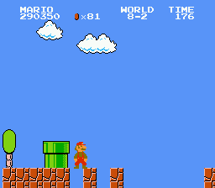
2D Level Design
Since movement is simpler in 2D, levels can demand more precise platforming.
Make sure the landing is visible
Don’t let the player fall through
platforms
Don’t make the player feel like
they don’t have total control

Slide 11
Summary
Platforming is all about precision
In 2D, precise control of the character’s movement is essential
Precise collision with platforms is just as essential
Ensure the character and wherever they’re trying to get to are always visible before a jump

Slide 12
References
Keren, Itay. 2016. GDC Vault - Scroll Back: The Theory and Practice of Cameras in Side - Scrollers. [ONLINE]
Available at: http://www.gdcvault.com/play/1022244/Scroll-Back-The-Theory-and. [Accessed 10 February 2016].
Monteiro, Rodrigo. 2016. The guide to implementing 2D platformers | Higher-Order Fun. [ONLINE]
Available at: http://higherorderfun.com/blog/2012/05/20/the-guide-to-implementing-2d-platformers/. [Accessed 10 February 2016].

